Slide 1
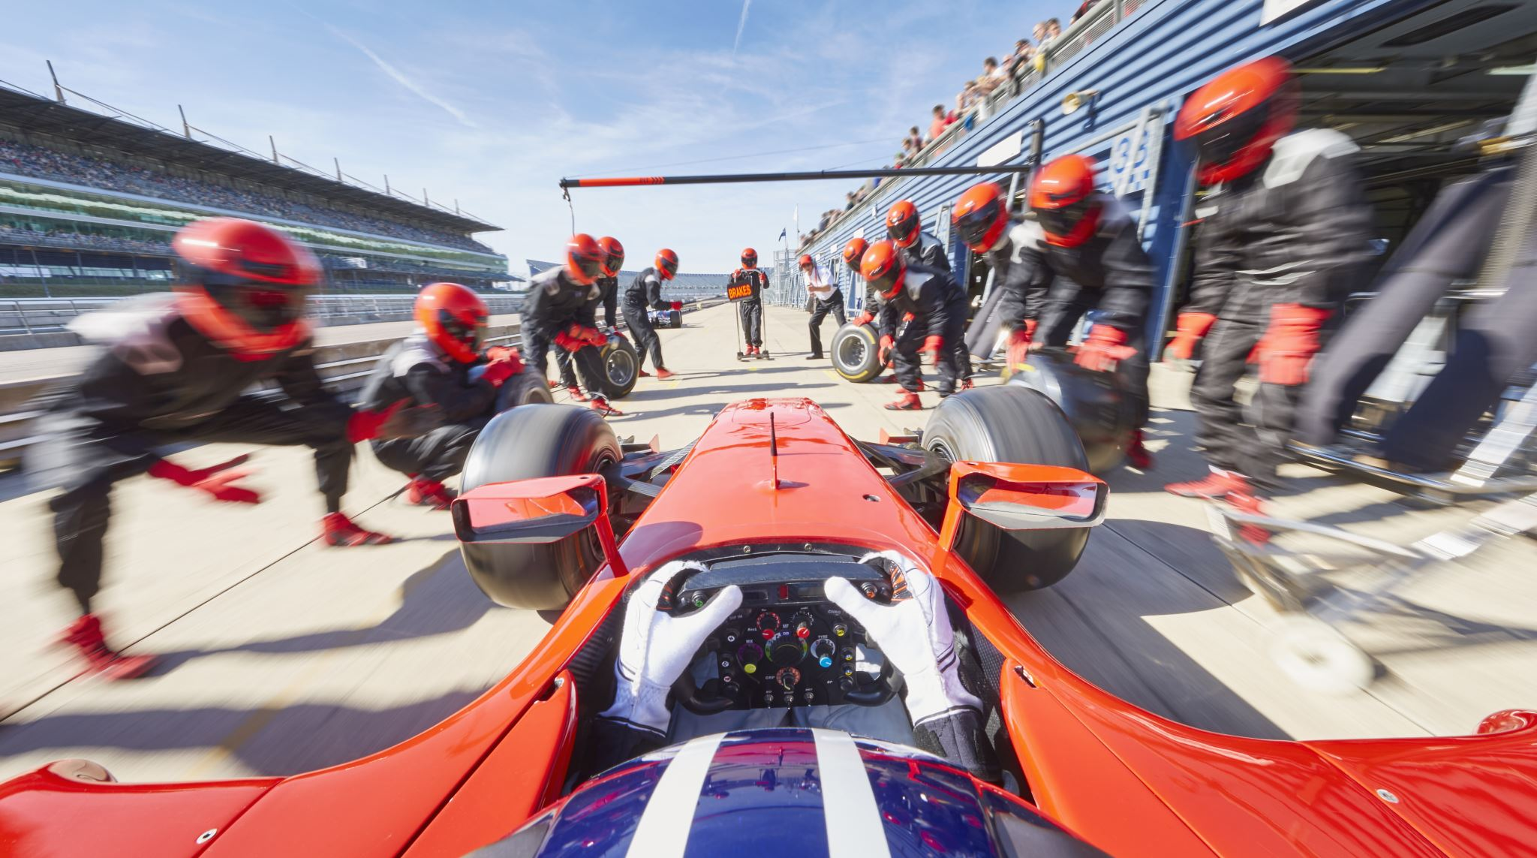
Modules 23,24 – Project 4
Formula One, Numbers, Facts, Directions

Slide 2
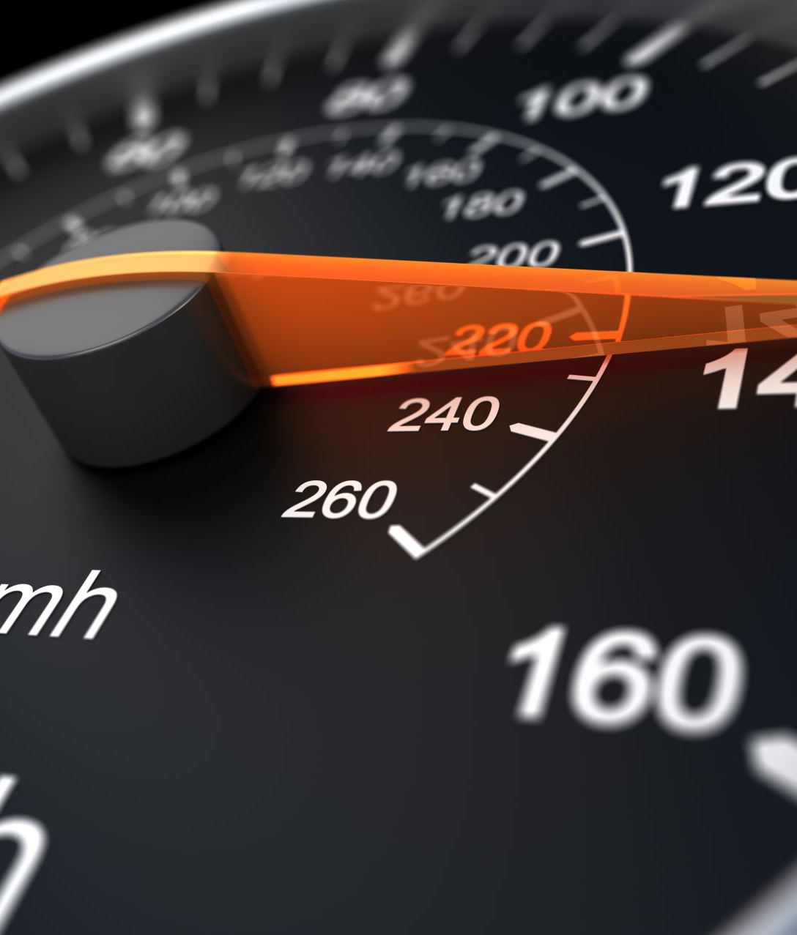
Data Cleaning Process
Tools Used to Clean the Data:
Python
Pandas
Jupyter Notebook

Slide 3
1950-2013 Data Diagram
Data Cleaning Pipeline
Merged different tables to get all the data’s required
Dropped unnecessary columns using the .drop function
Cleaned
Dataframe
Cleaned
.CSV
.CSV Source file
Python
Panda
Dataframe
Sorted the data by year
Decoded the foreign names

Slide 4
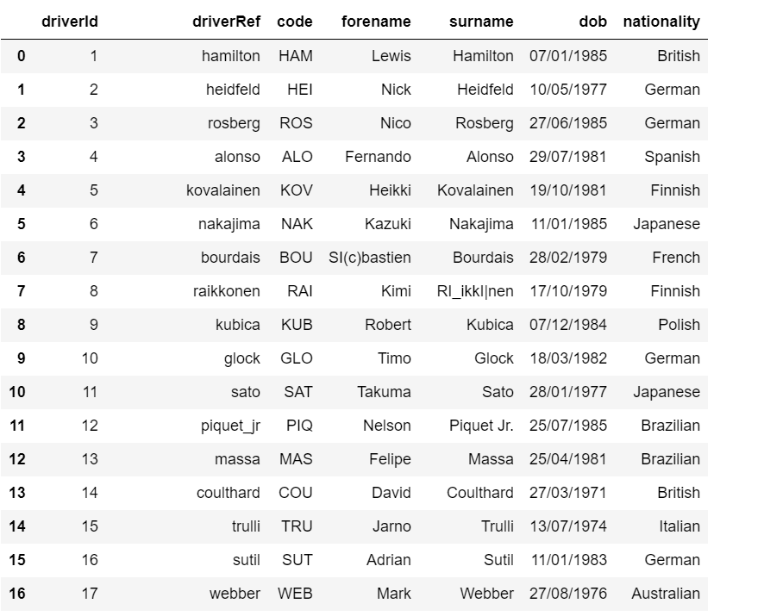

Slide 5
2013-2022 Data Diagram
Data Cleaning Pipeline
Dropped columns to remove unnecessary data
Decoded the foreign names
Cleaned
Data frame
Cleaned
.CSV
.CSV Source file
Python
Panda
Data frame
Filter out non-integer values in the multiple columns
Filtered the top 10 drivers

Slide 6
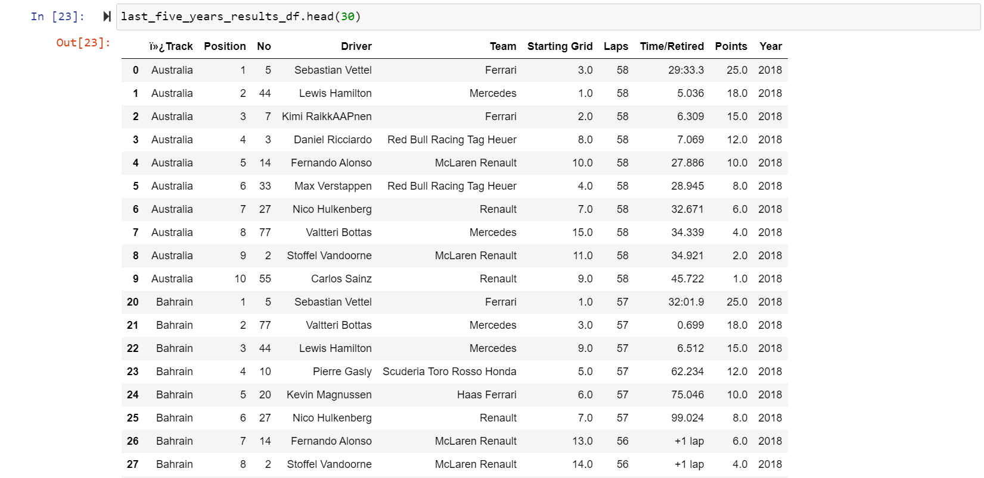

Slide 7
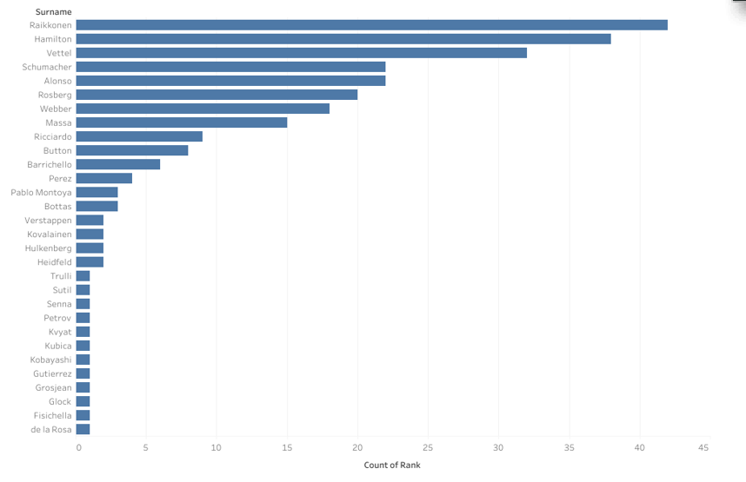
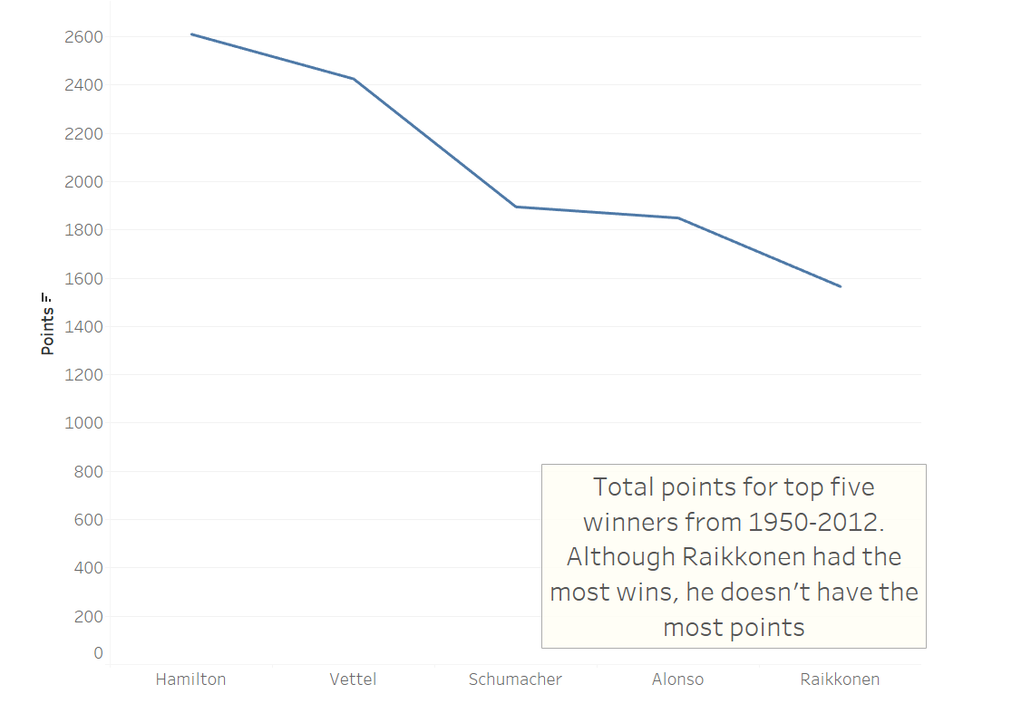
Rider with Most Wins and Points from 1950-2012

Slide 8
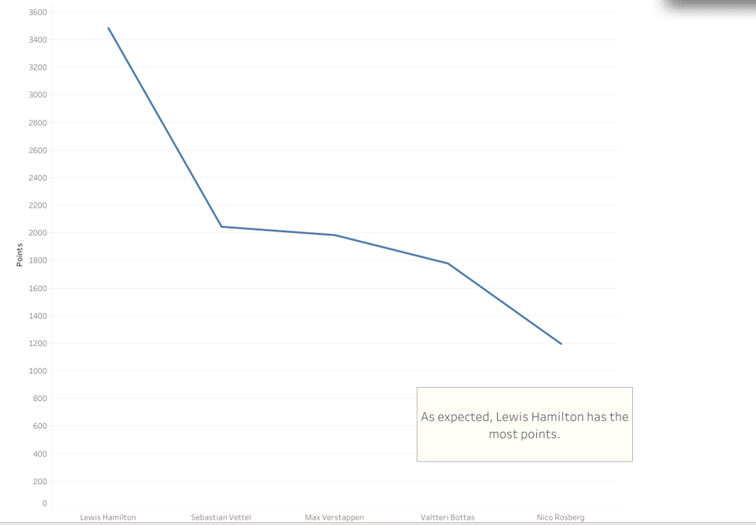
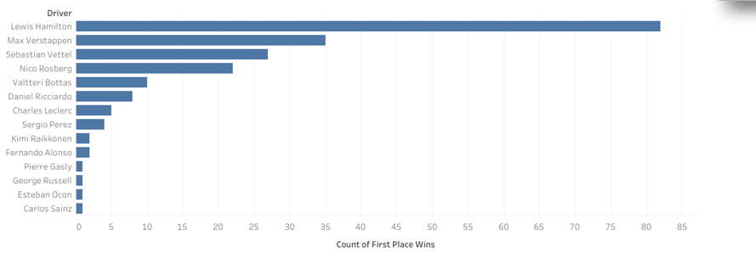
Rider with Most Wins and Points from 2012-2022

Slide 9
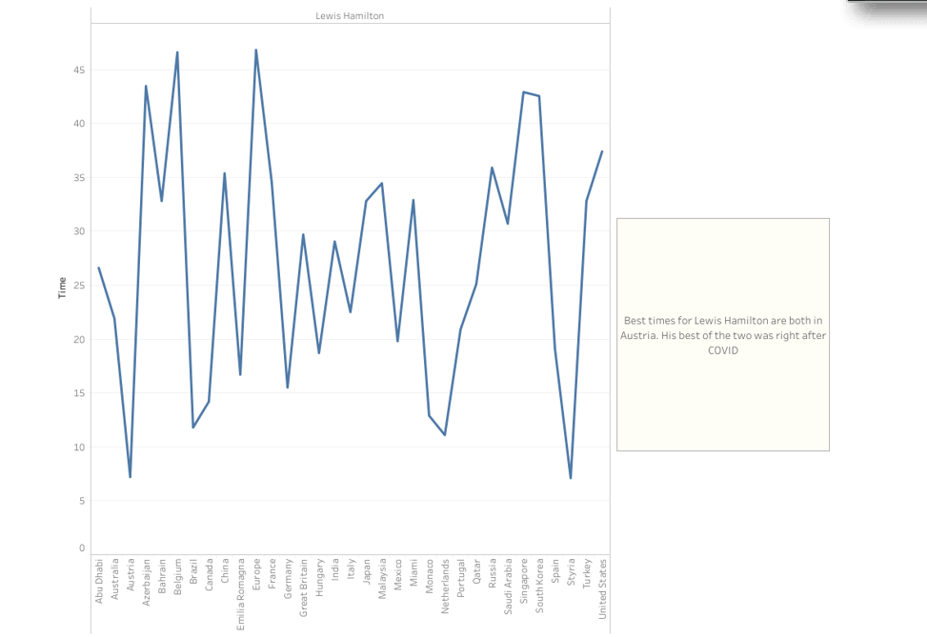
Lewis Hamilton’s Best Times In The Last 10 Years

Slide 10
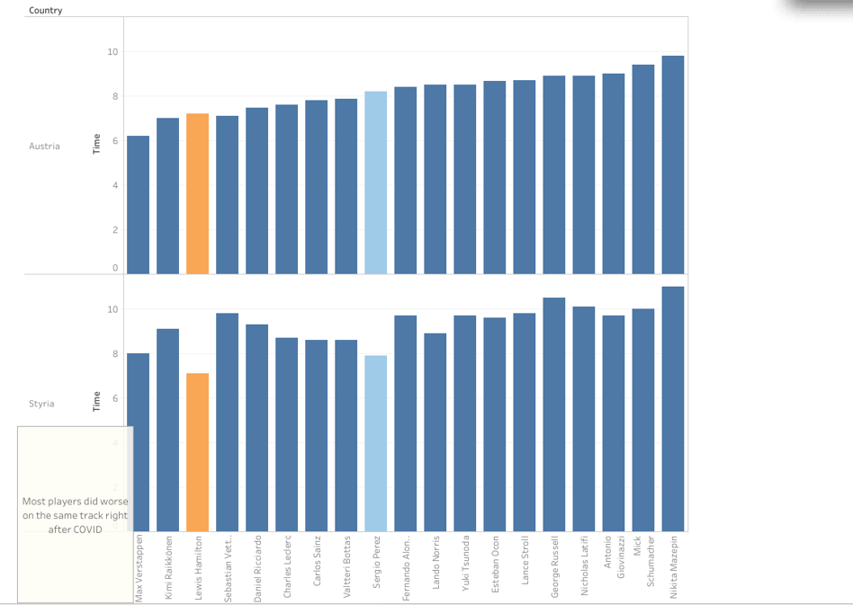
Drivers Times Pre and Post Covid on Austria Track

Slide 11
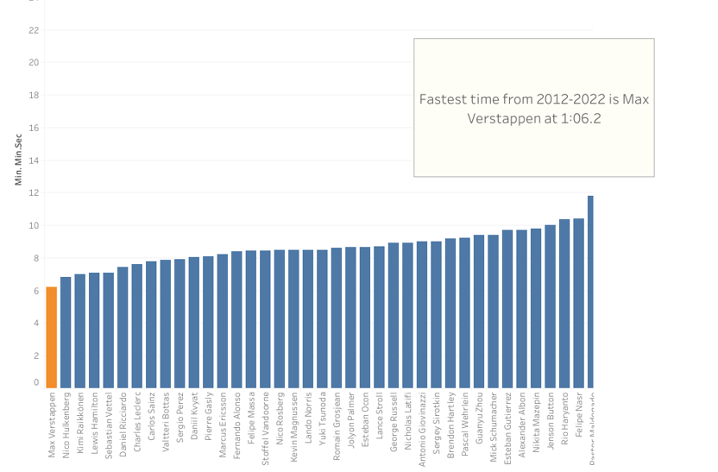
Overall Fastest Time In The Last 10 Years

Slide 12
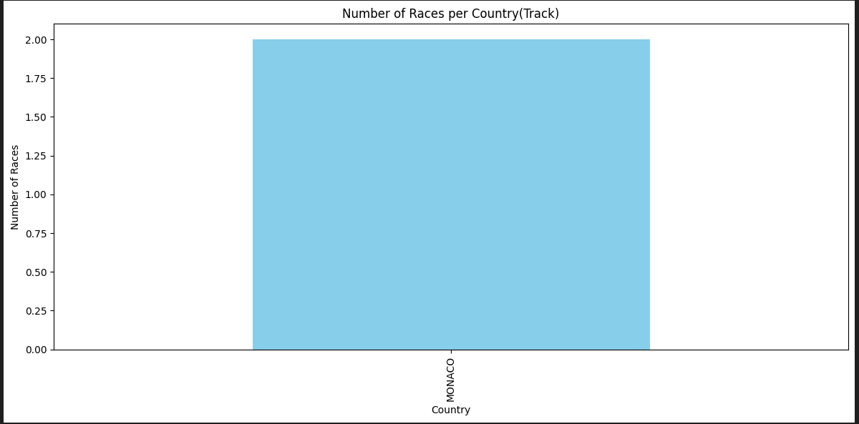
Number of Races per Track

Slide 13
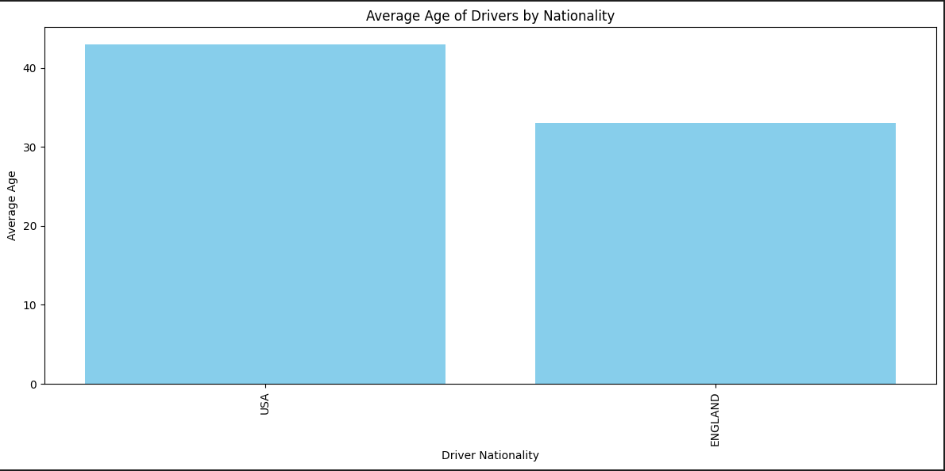
Average Age of Drivers by Nationality

Slide 14
Machine Learning
Formula One and Machine Learning
Can a model be created and trained? Yes
Can predictions can be made? Yes
Relatively easy for isolated races
Relatively difficult for the whole championship

Slide 15
Machine Learning
Used as many approaches as possible and many techniques as applicable
Linear Regression
Logistic Regression
Random Forest Classifier
Random Forest Regressor
MLP Classifier
MLP Regressor
All Solvers

Slide 16
Machine Learning
Technology used:
Python
Jupyter
Pandas
MongoDB
Beautiful Soup
Selenium
Scikit Learn
Pretty Print
Numpy
APIs to retrieve data from websites

Slide 17
Machine Learning
Number of features used varied from 10 to 25, including local weather factors, driver age, etc.
Running time varied from 5 minutes to hundreds of hours (up to never ending loop)
Computers used are high-end, with more than 20 cores.

Slide 18
Machine Learning
Lessons learned
Study carefully what features could and should be used. More features may represent more accuracy, but implications in the performance aspects can be terrible.
Nothing can more useless than the right answer that comes too late.
Identify trusted sources when looking for resources for the project. An appealing and good-looking library may produce very misguided results.
If possible, test all the code in different environments

Slide 19
And The Winner Is…
Leclerc with 95% Precision
But that was incorrect as Verstappen won the 2023 season

